Slide 1
Differential CTLE
Chavalla Santhosh

Slide 2
Specifications : all are given except VCM
PDK | gpdk90nm
Supply | 1.2 V
Data Rate | 8Gbps
Peaking | 12dB@4GHz (got 10dB)
DC Gain | 0 dB (got -4.1 dB)
VCM | 650 mV - 850 mV
Bode Approximation
Reason
This is not given
Designed for this:

Slide 3
Design Procedure
Characterise FET
Find (gm,Rd) values and verify small signal model
Verify entire circuit

Slide 4
Characterize FET

Slide 5
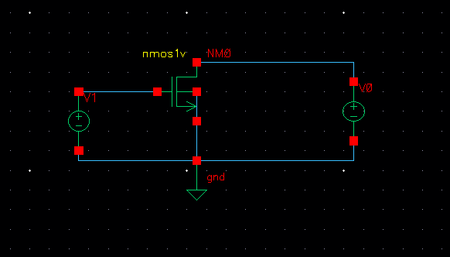
W/L=120n/300n : assuming vds=300m
Generate the following curves assuming Vds=300m(VDsat=220mV): (DC simulations), keep L >500n, assuming no channel length modulation
adel>dc simulations>save DC operating point>sweep variable>component parameter>select component>0.1v-1.0v
1. results > annotate>dc operating points
a. generate Id vs Vgs
b. generate gm vs Vgs (send Id curve to caluculator>deriv>evaluate plot>copy and paste in same window)
c. gm/Id vs Vgs

Slide 6
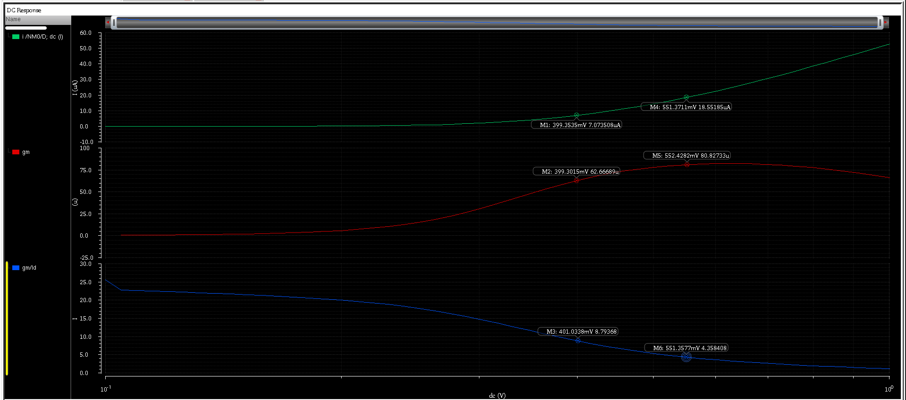
gm/Id ratio is constant as W increases, both Id and gm scale with W assumed : FET in saturation & VDS
Formulae??

Slide 7
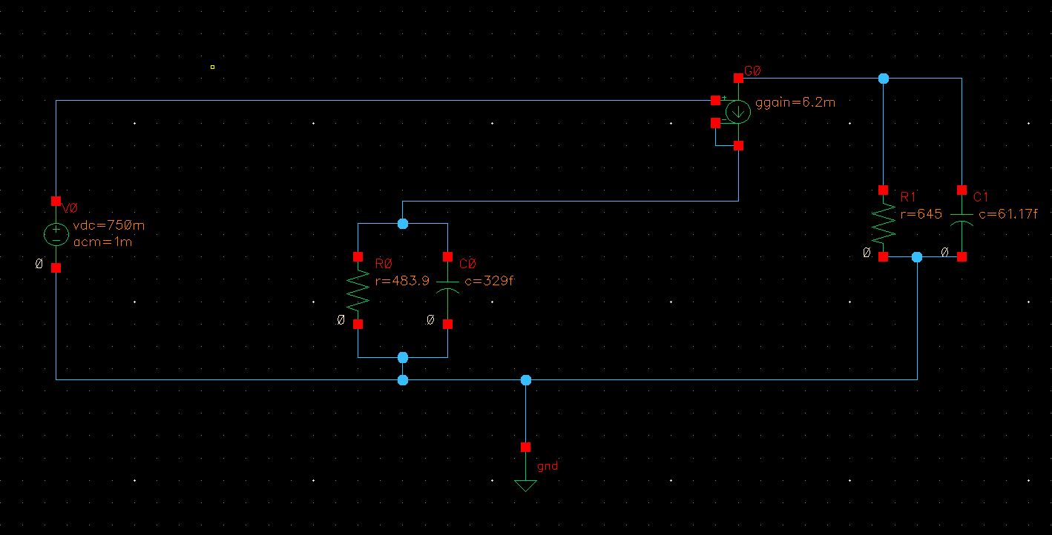
Draw small signal ckt as shown and verify:
voltage source choose vdc> enter dc voltage(vg=vcm)> enter ac magnitude > ok
1.launch> adel>ac/dc/trans/ analysis > pz > choose i/p and o/p voltage nodes > no sweep variable > ok >run >pop up window will reflect
2.launch> adel>ac/dc/trans/ analysis > ac >sweep variable>frequency> 1K-10G > results > direct plot > ac gain & phase

Slide 8
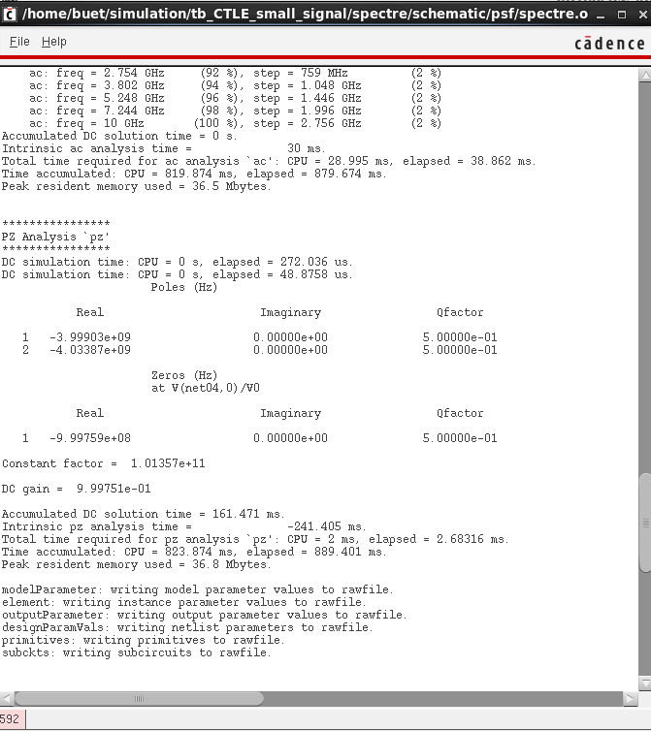

Slide 9
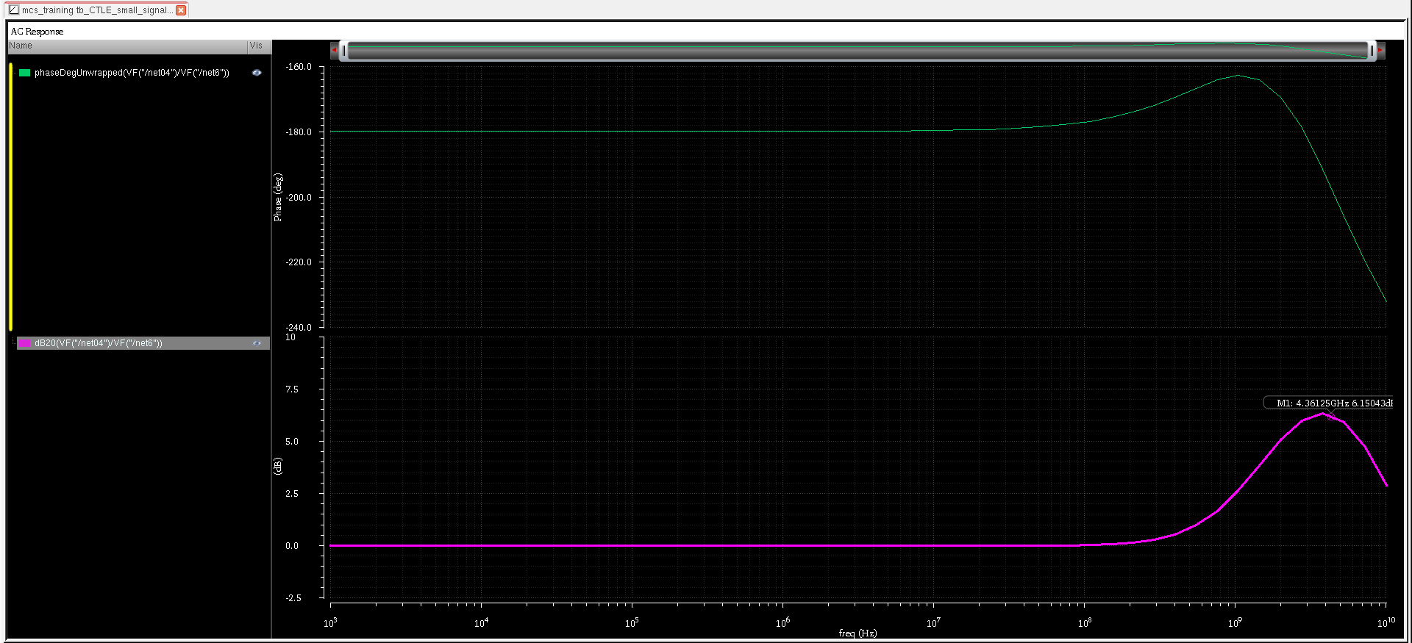
Designed for 12dB peak gain but got 6dB due to Bode’s approximation rule

Slide 10
Complete 2-Stage CTLE

Slide 11
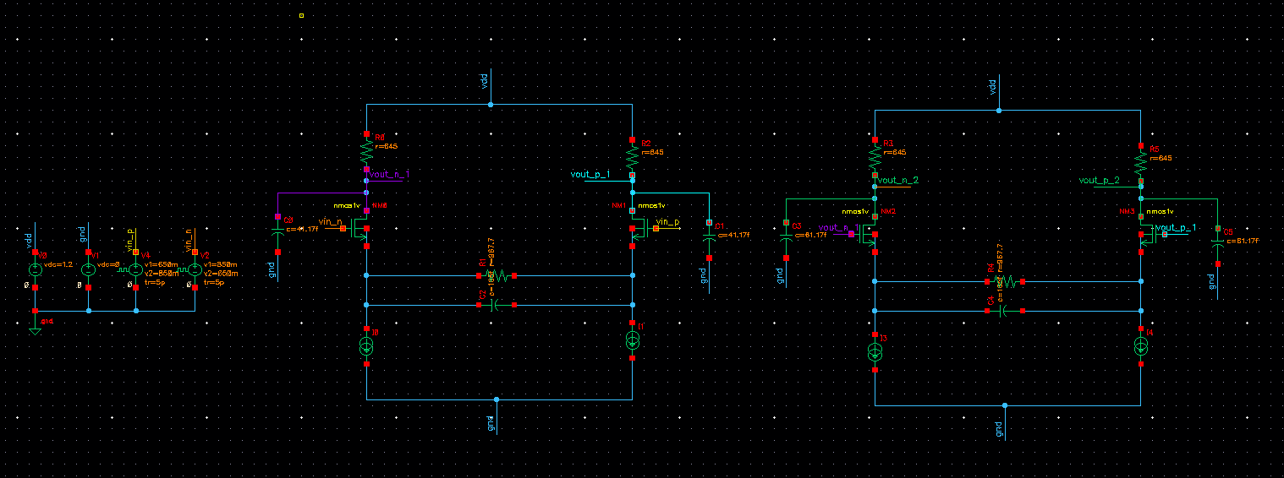
CL of first stage reduced by Cgg (20fF) of second stage
vpulse with swing 850mV-650mv, both are 180 degrees out of phase
125ps period, 5ps rise/fall time

Slide 12
Transient Simulations
3. transient analysis
8Gbps(4GHz Nyqvist Frequency) data rate 125ps period-850m-650m voltage sources (5ps rise/fall time)
delay introduced between each stage
need to analyze more Swings in ctle/opamp: small signal + large signal

Slide 13
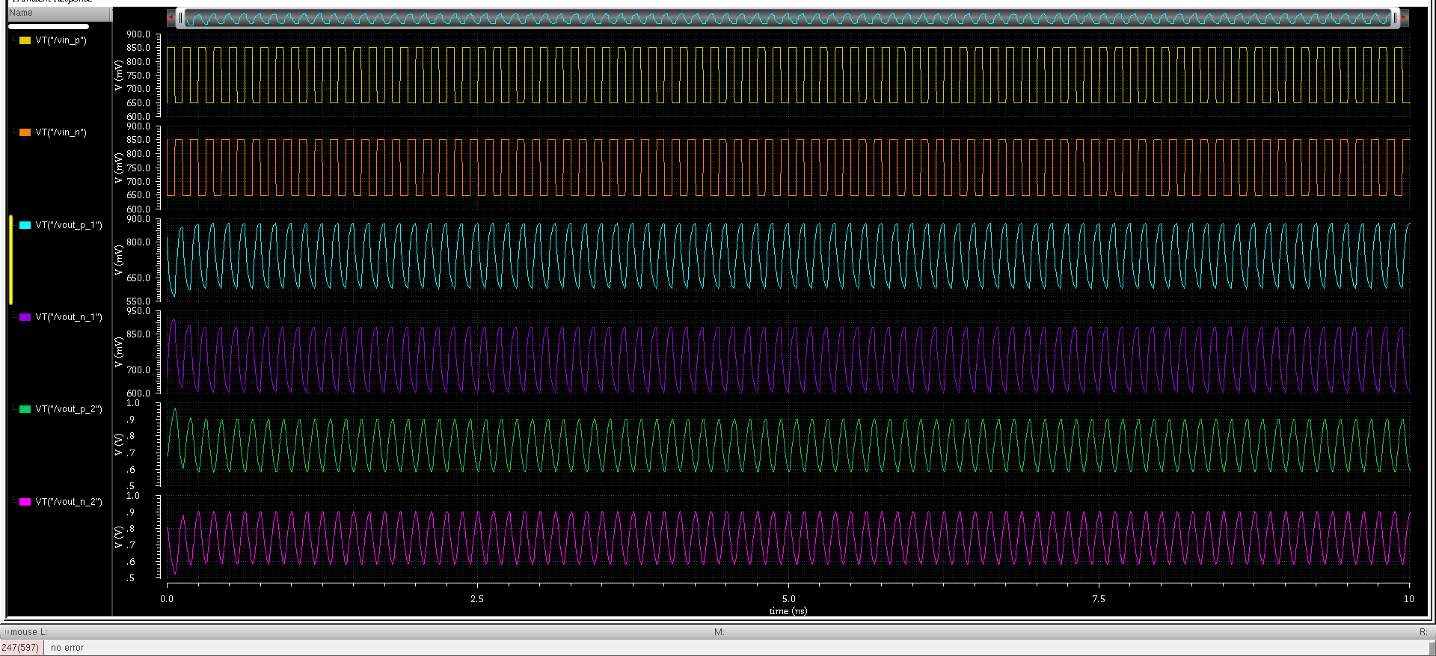
time shift, swing is different after 1 and 2 stage and CM voltage

Slide 14
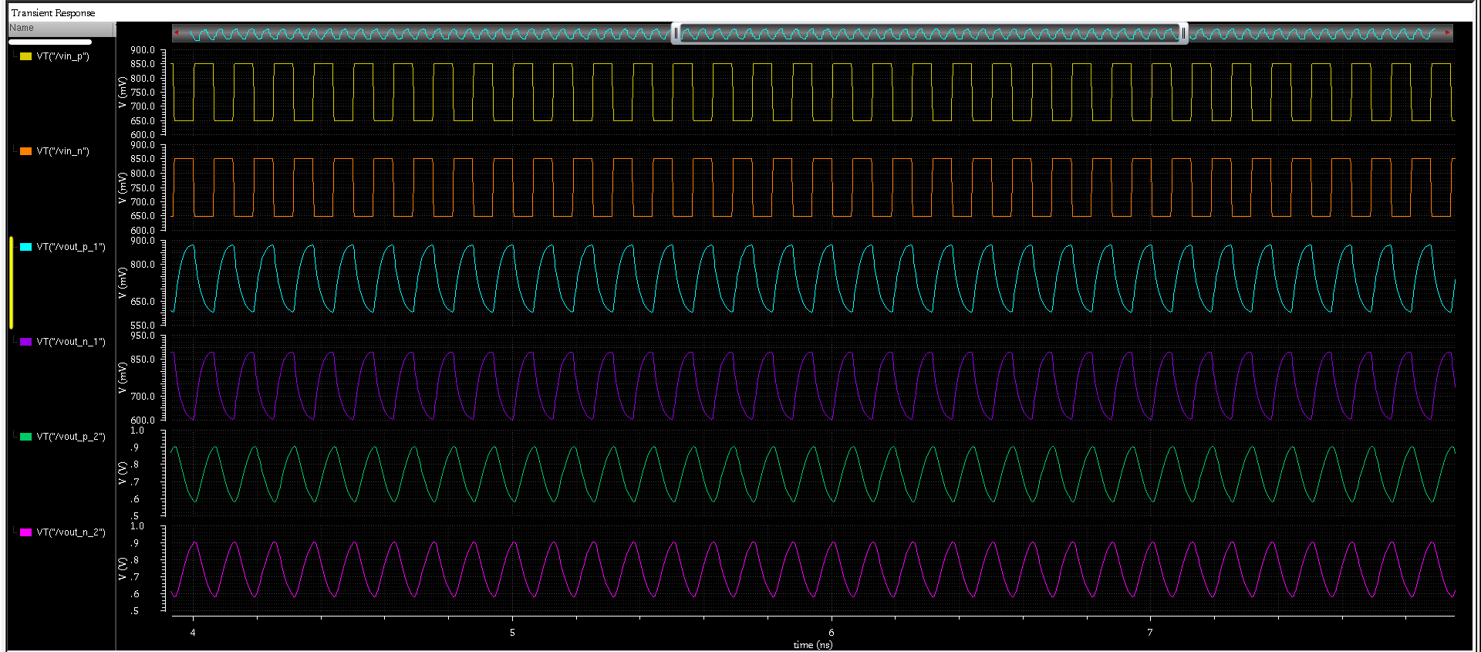
Zoomed in:

Slide 15
AC Simulations
ac analysis with vcm=750m
give AC magnitude for one of the vpulse sources=1.0V
results>direct plot>main form > analysis (ac)> function (voltage)> select differential nets > db20

Slide 16
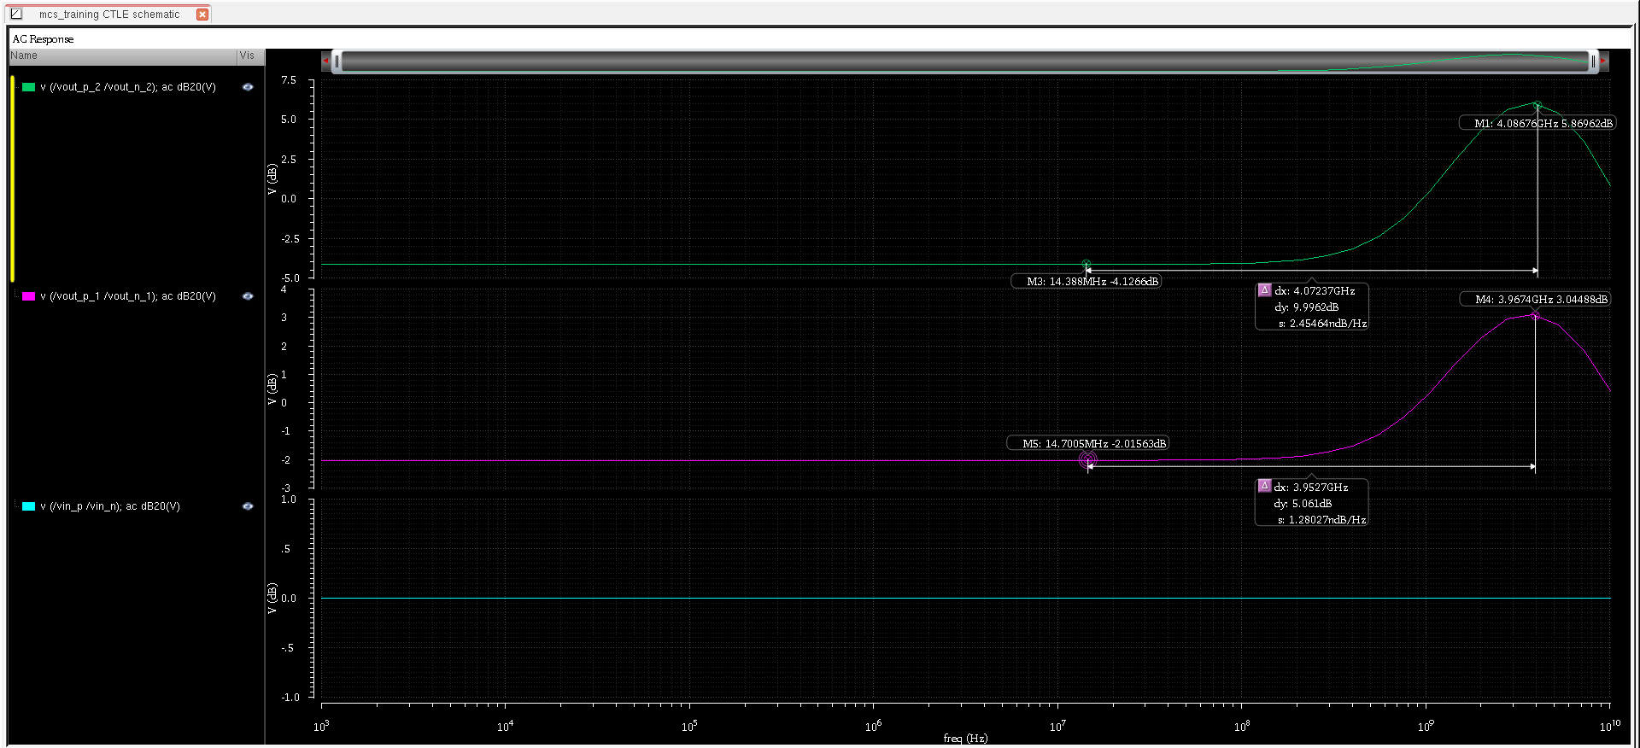

Slide 17
DC Simulations
1. dc analysis over common mode range 2 stages separately
enter dc voltage=650m for both vpulse sources
enter dc voltage=850m for both vpulse sources

Slide 18
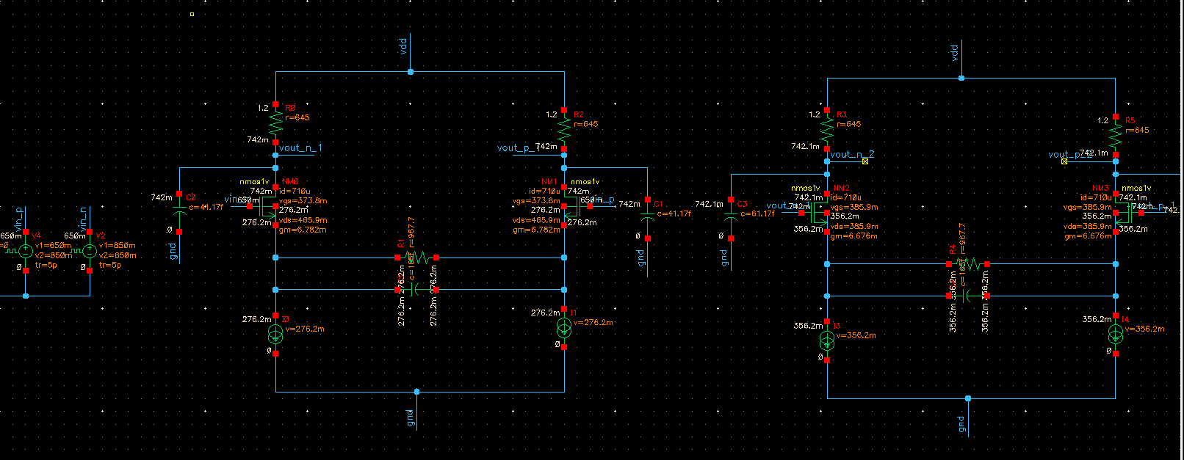
VCM=650mV
Re draw schematic with proper current values
Annotate node voltages & currents
Vth=200mV, Vdsat=220mV
note of gm value = 6.782mS

Slide 19
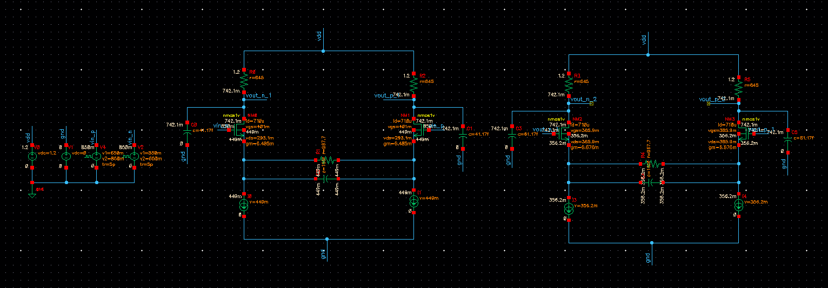
VCM=850mV
Vth=200mV, Vdsat=220mV
note of gm value = 6.485 mS

